Slide 1
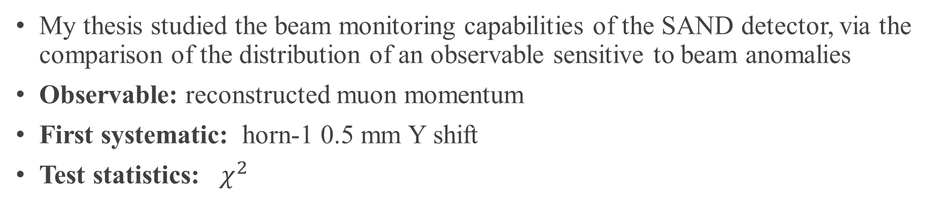
BEAM MONITORING WITH SAND
My thesis studied the beam monitoring capabilities of the SAND detector, via the comparison of the distribution of an observable sensitive to beam anomalies
Observable: reconstructed muon momentum
First systematic: horn-1 0.5 mm Y shift
Test statistics: $χ^{2}$

Slide 2
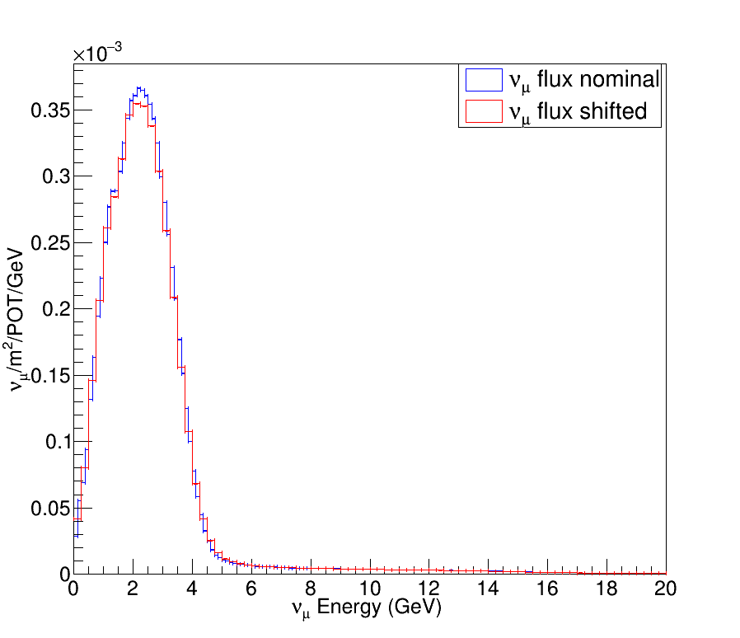
Simulated samples
Simulated samples from :
Nominal neutrino flux
Shifted neutrino flux (Y +0.5mm in the first beam horn)
Note : Histograms retrieved from https://home.fnal.gov/~ljf26/DUNEFluxes

Slide 3
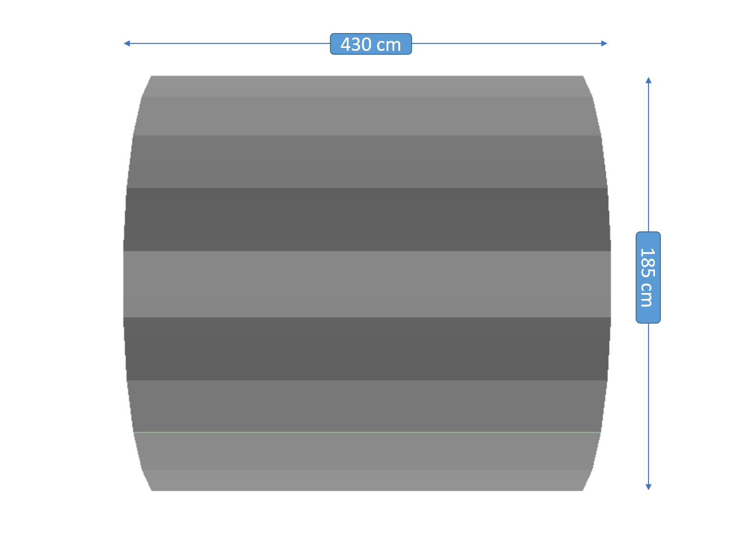
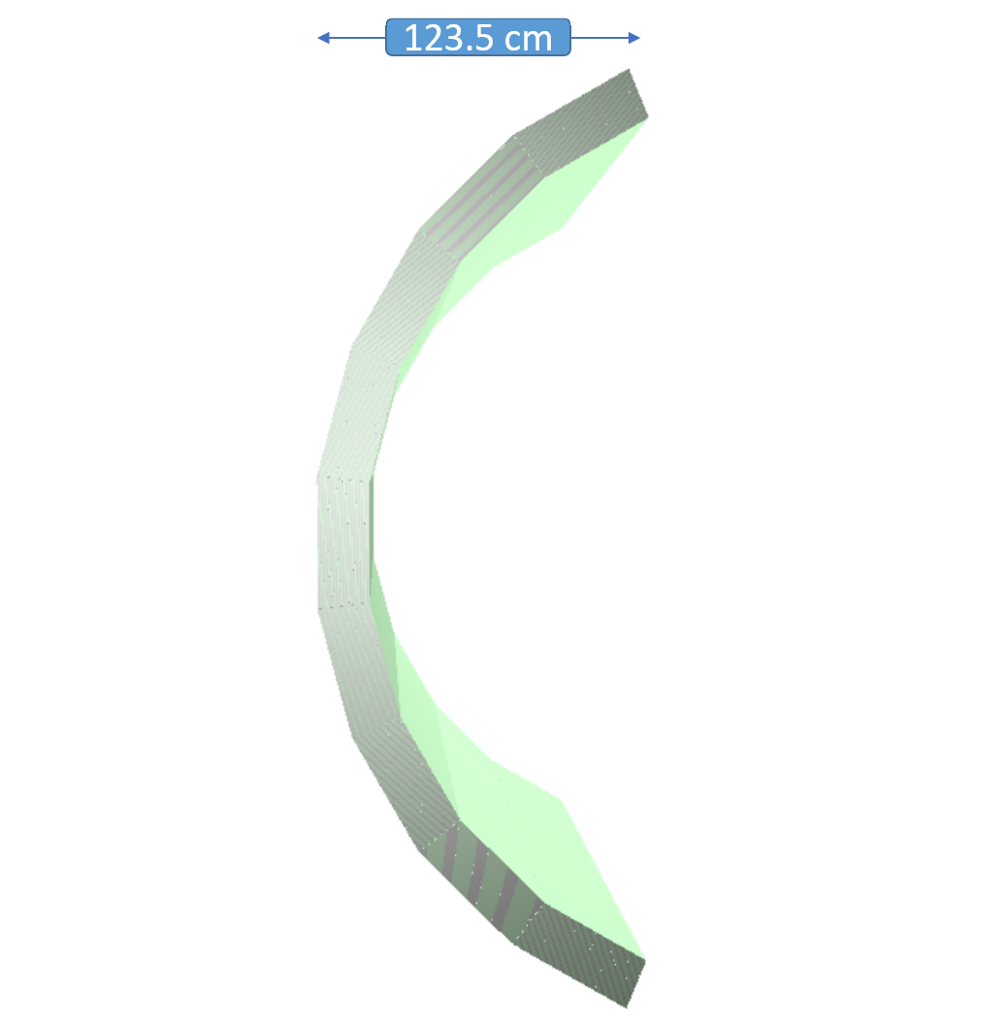
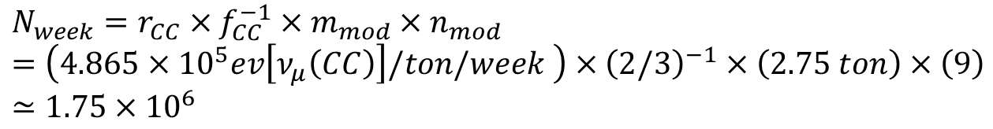
Target: front calorimeters
Dunendggd simulated geometry
Target: 9 front calorimeter barrel modules
$$N_{week}=r_{CC}×f_{CC}^{−1}×m_{mod}×n_{mod}=\left(4.865×{10}^{5}ev\left[ν_{μ}\left(CC\right)\right]/ton/week \right)×{\left(2/3\right)}^{−1}×\left(2.75 ton\right)×\left(9\right)≃1.75×{10}^{6}$$
One week’s worth of statistics

Slide 4
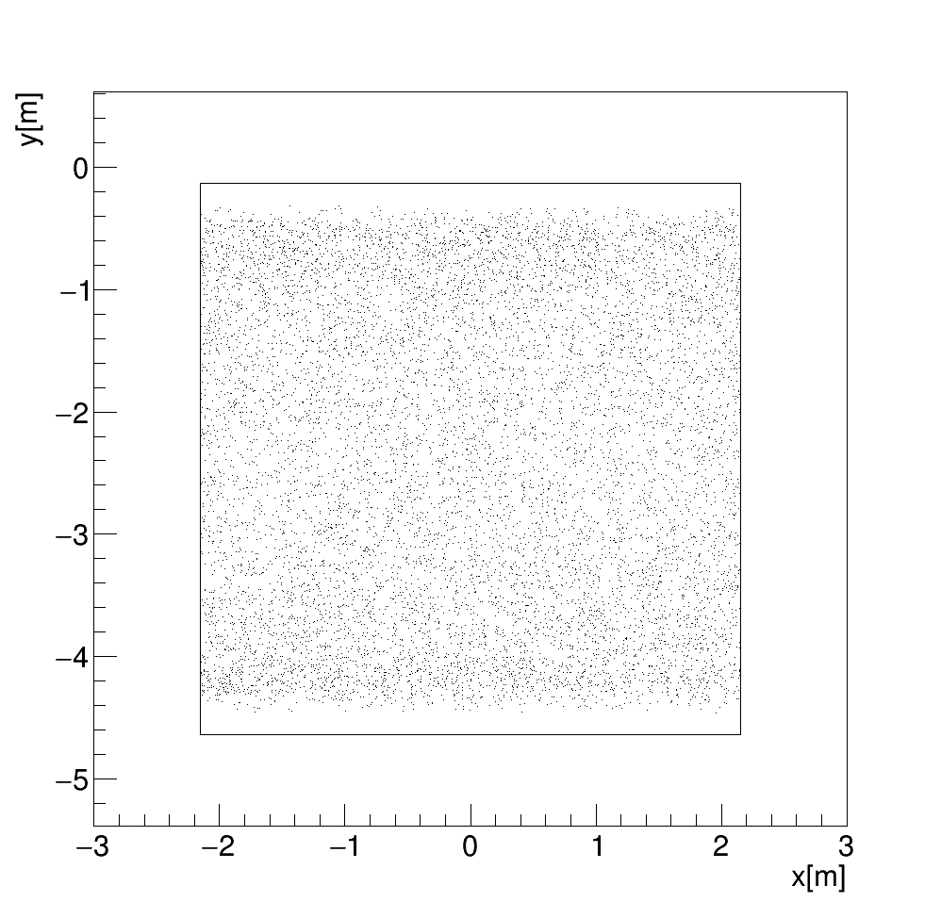
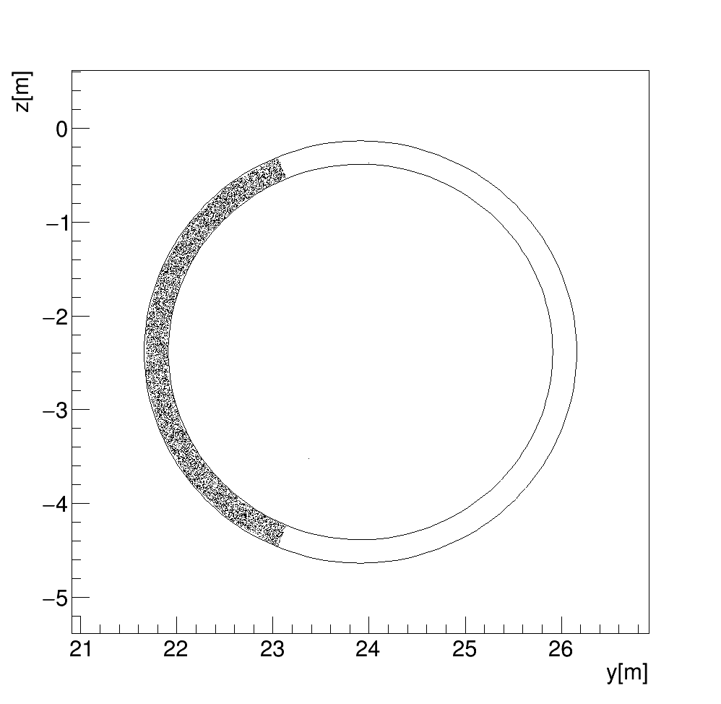
Target: front calorimeters
Interaction vertex distributions on the xy and yz planes
$$N_{week}=r_{CC}×f_{CC}^{−1}×m_{mod}×n_{mod}=\left(4.865×{10}^{5}ev\left[ν_{μ}\left(CC\right)\right]/ton/week \right)×{\left(2/3\right)}^{−1}×\left(2.75 ton\right)×\left(9\right)≃1.75×{10}^{6}$$
One week’s worth of statistics

Slide 5
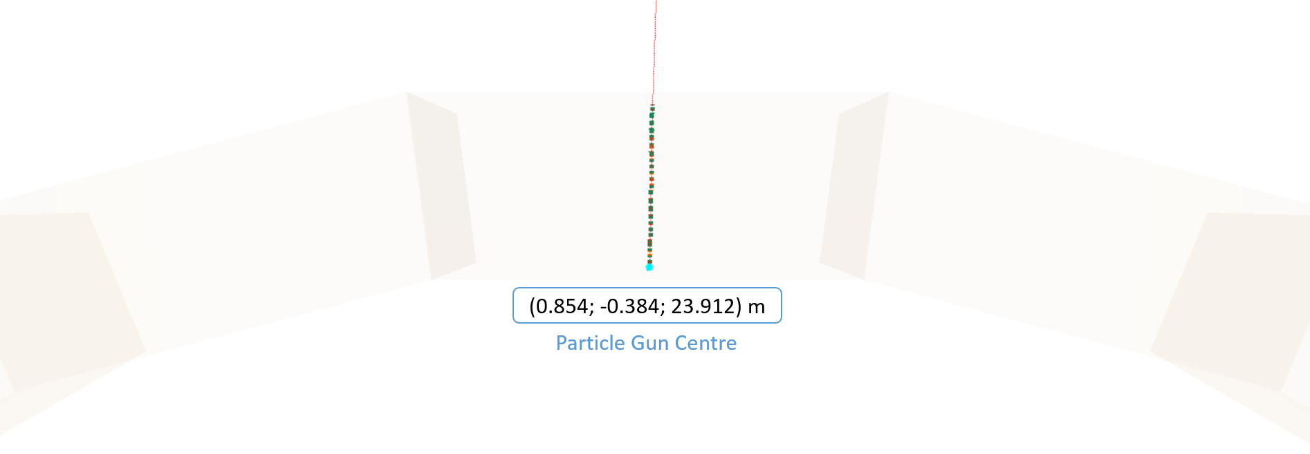
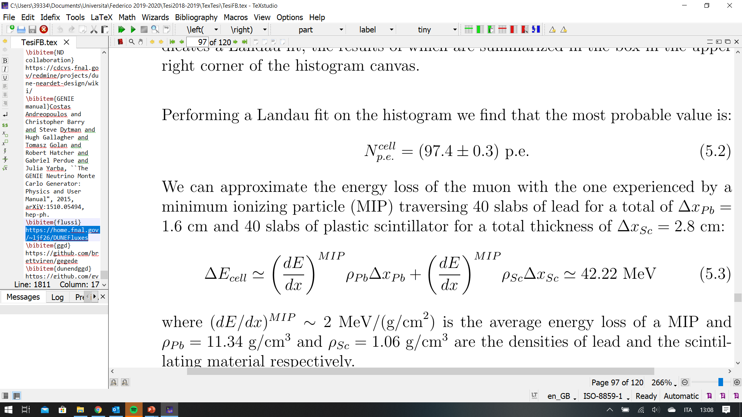
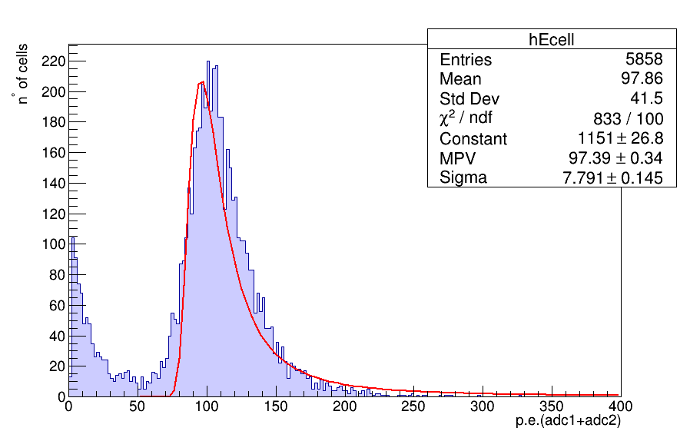
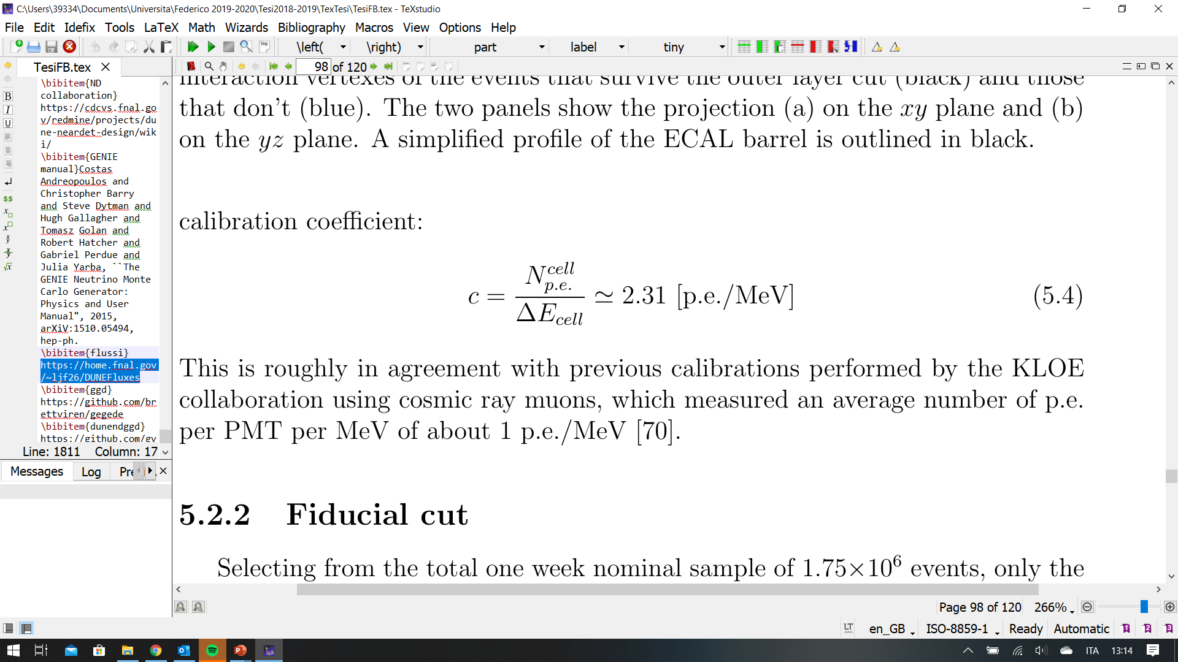
Preliminary measurement: light yield
Simulated 1000 muons at 10 GeV passing through an ECAL barrel module

Slide 6
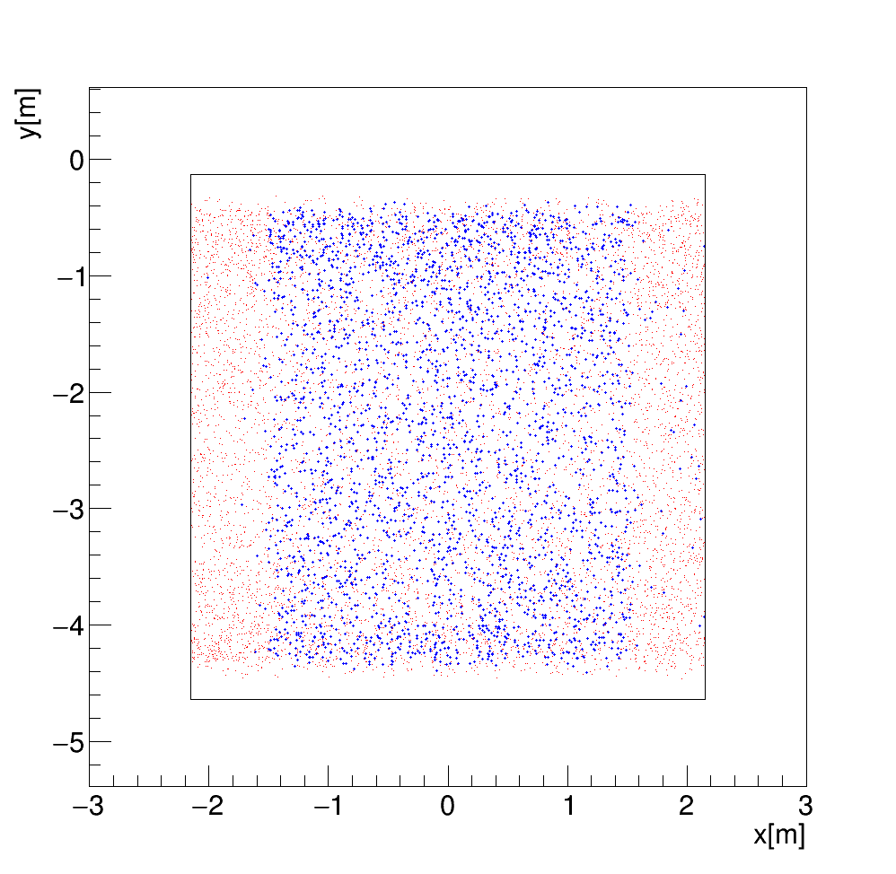
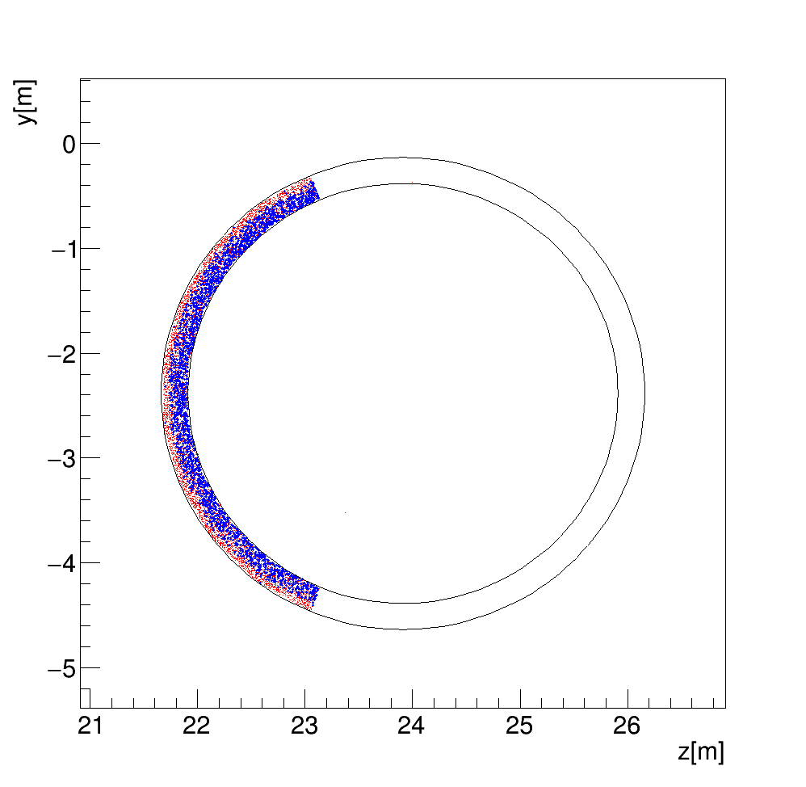
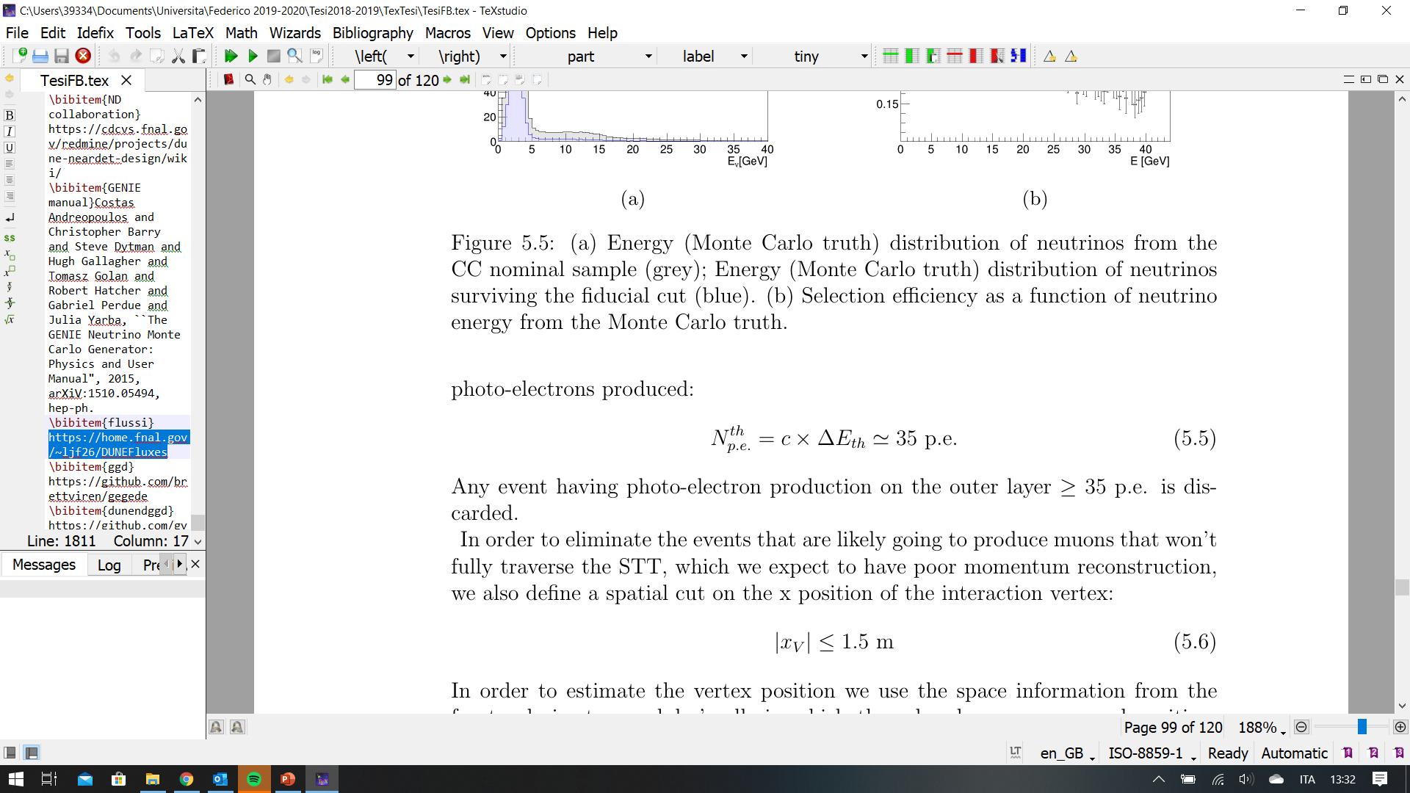
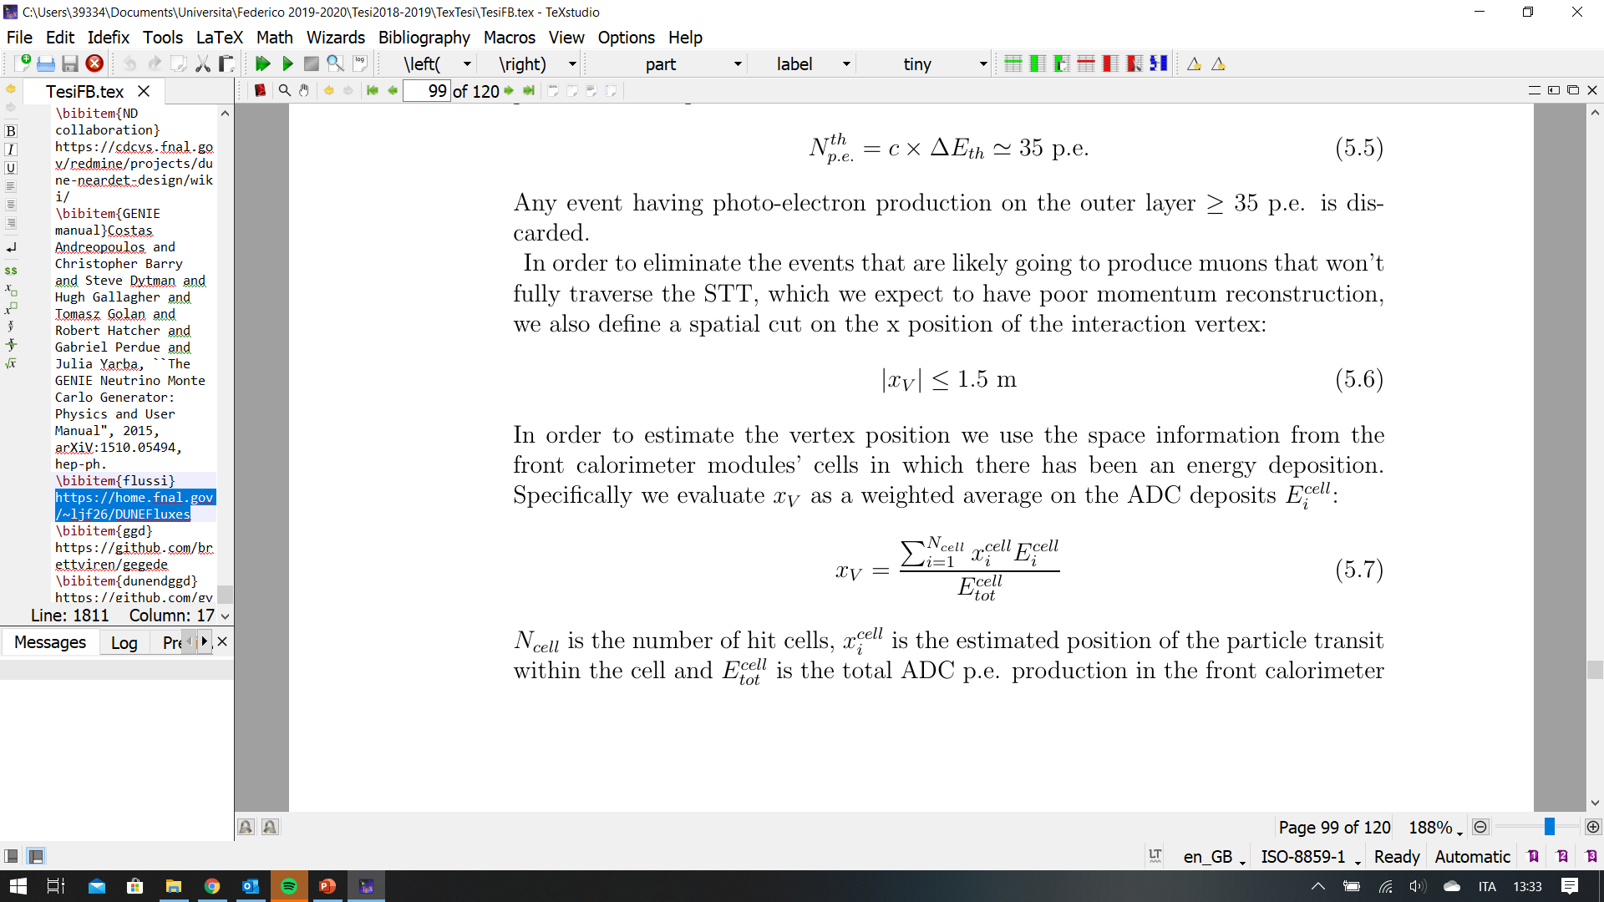
Fiducial cut
Threshold on the energy deposition on the outer layer (E < 15MeV):
X vertex, estimated as a weighted average on the energy deposition on the cells, is selected as:
Spatial distribution in ND hall global coordinates of the true neutrino interaction vertexes of the events that survive the fiducial cut (blue) and those that don’t (red).

Slide 7
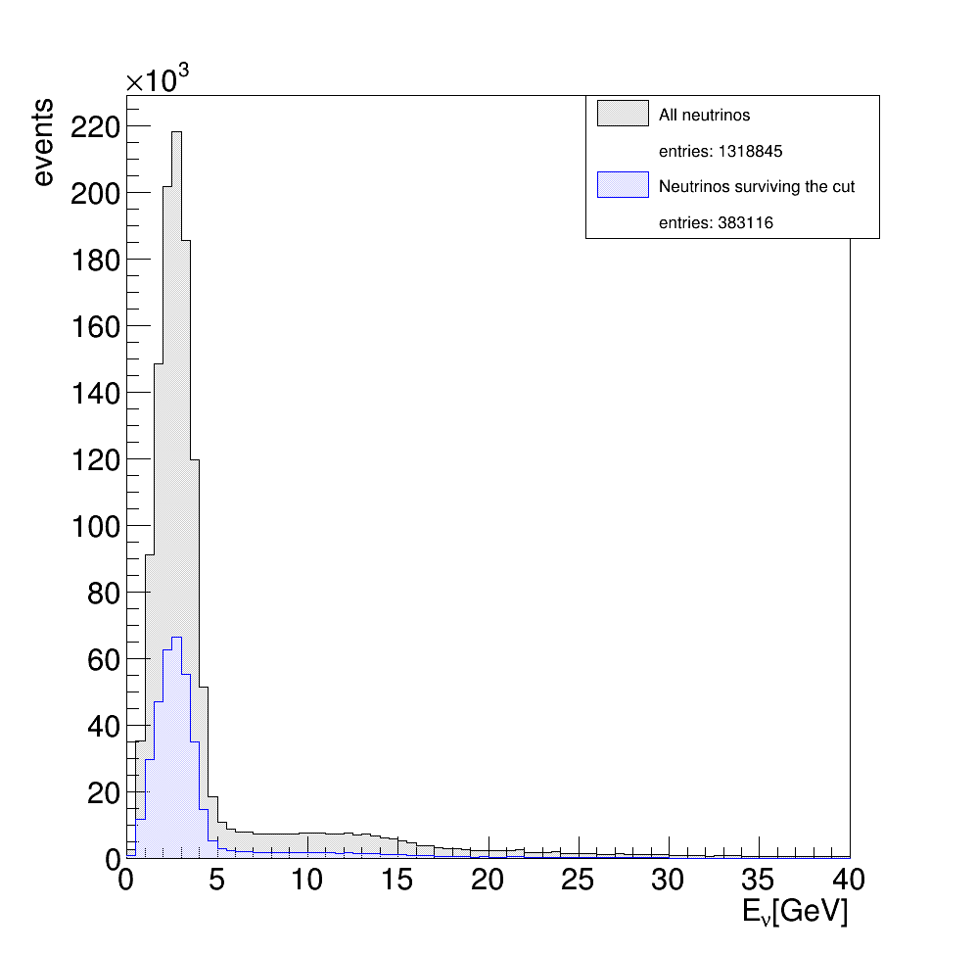
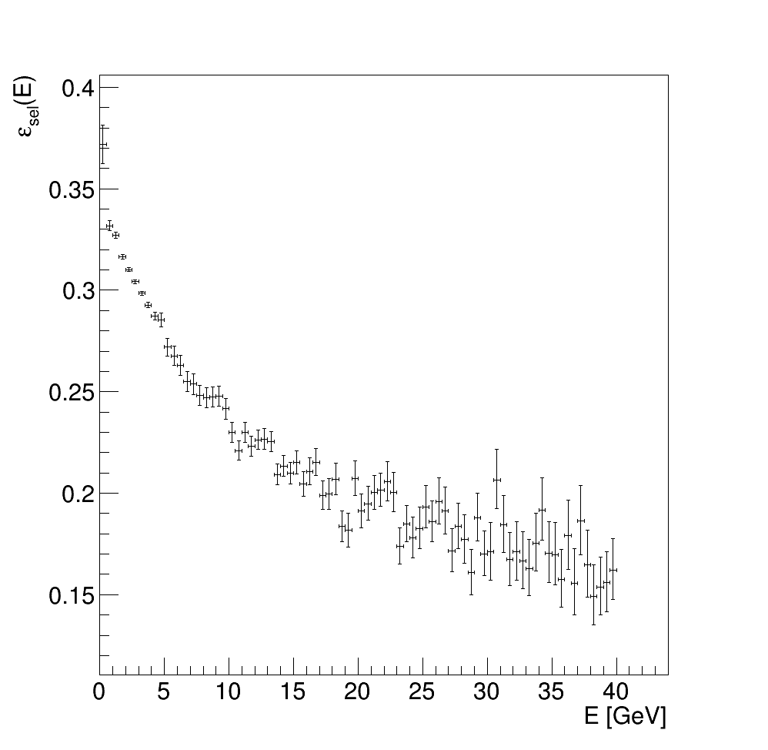
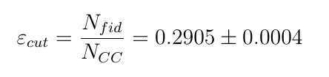
Fiducial cut
Selection efficiency:
Note: efficiency decreases at higher energy; might be due to nuclei fragmentation in DIS
(Left) Energy (Monte Carlo truth) distribution of neutrinos from the CC nominal sample (grey); distribution surviving the fiducial cut (blue).
(Right) Selection efficiency as a function of neutrino energy from the Monte Carlo truth.

Slide 8
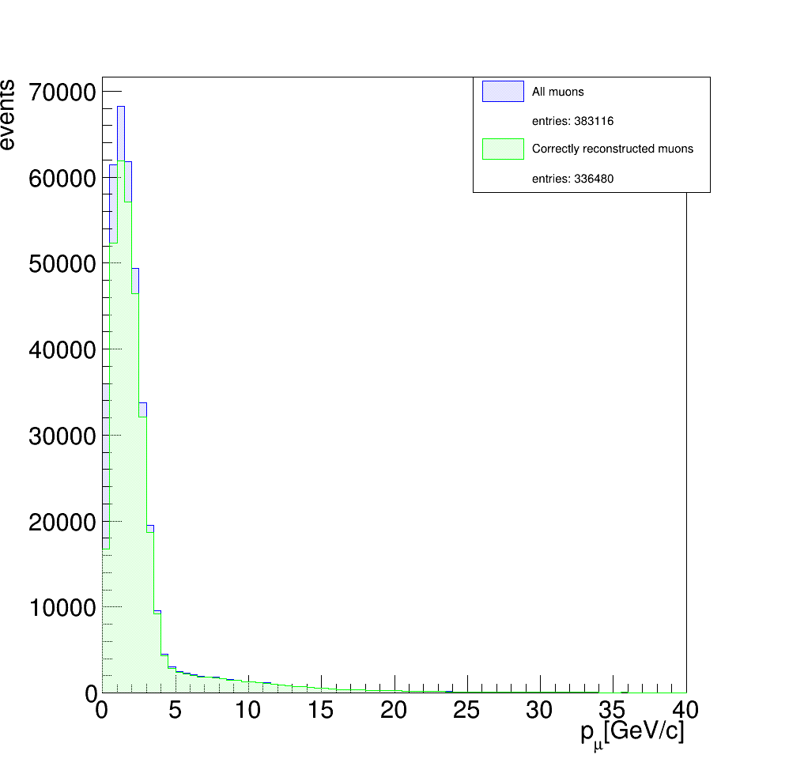
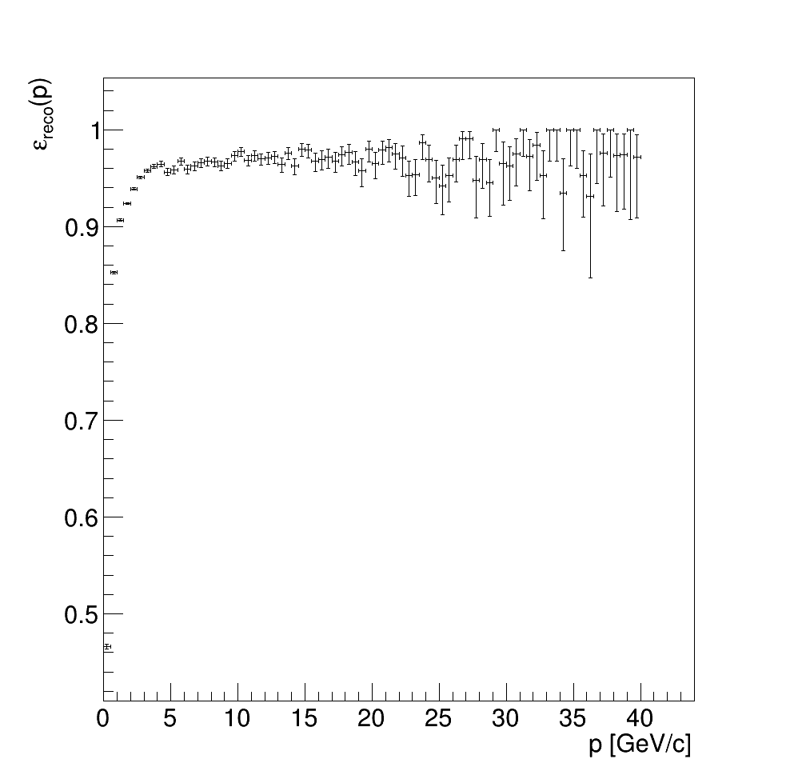
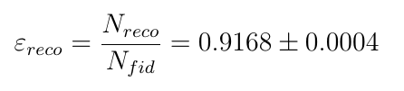
Momentum reconstruction selection
Momentum reconstruction efficiency:
(Left) Distributions of the true Monte Carlo momenta of the muons from the fiducial sample (blue) and only the ones correctly reconstructed (green).
(Right) Reconstruction algorithm efficiency as a function of the true Monte Carlo muon momentum

Slide 9
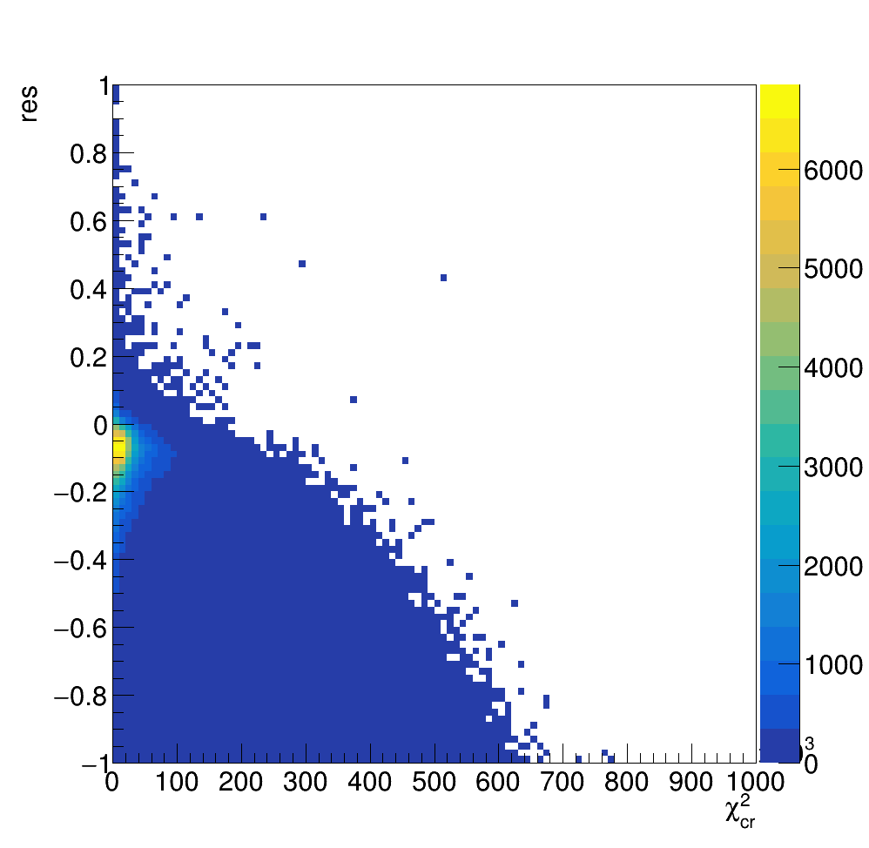
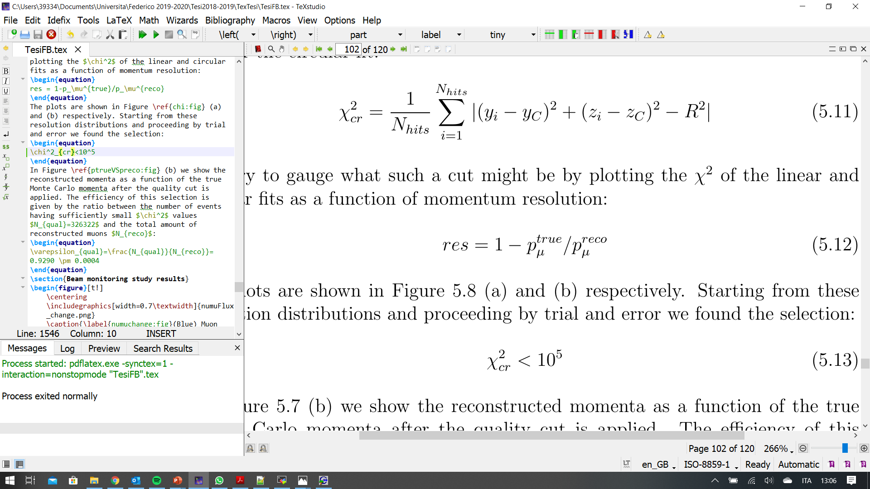
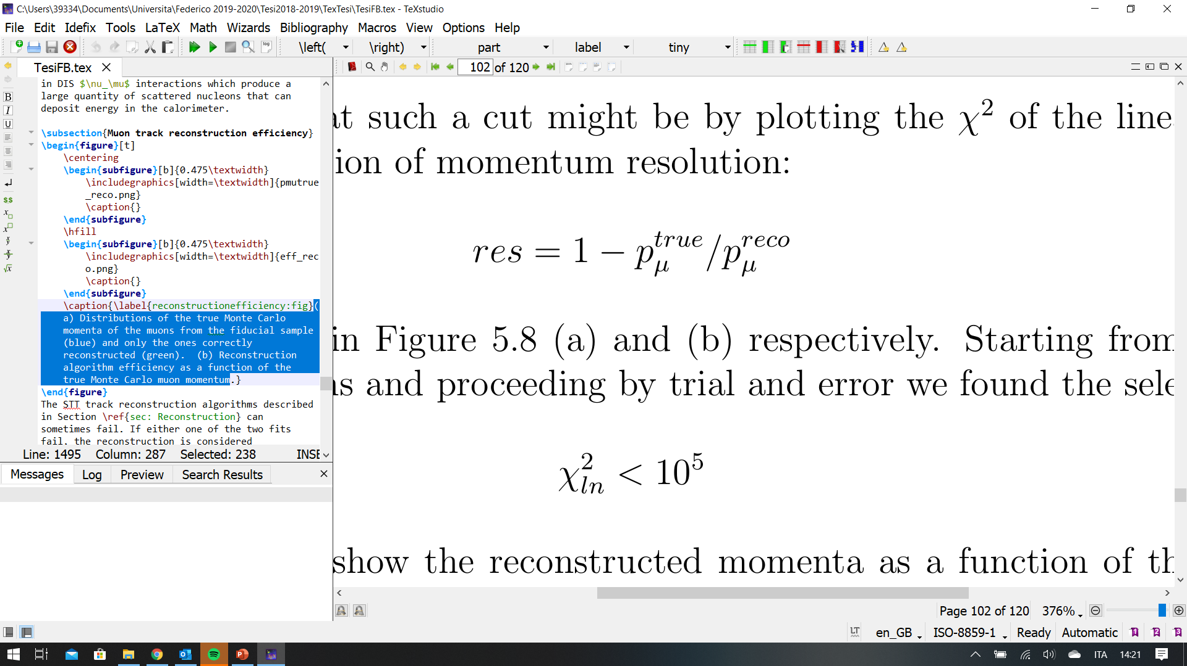

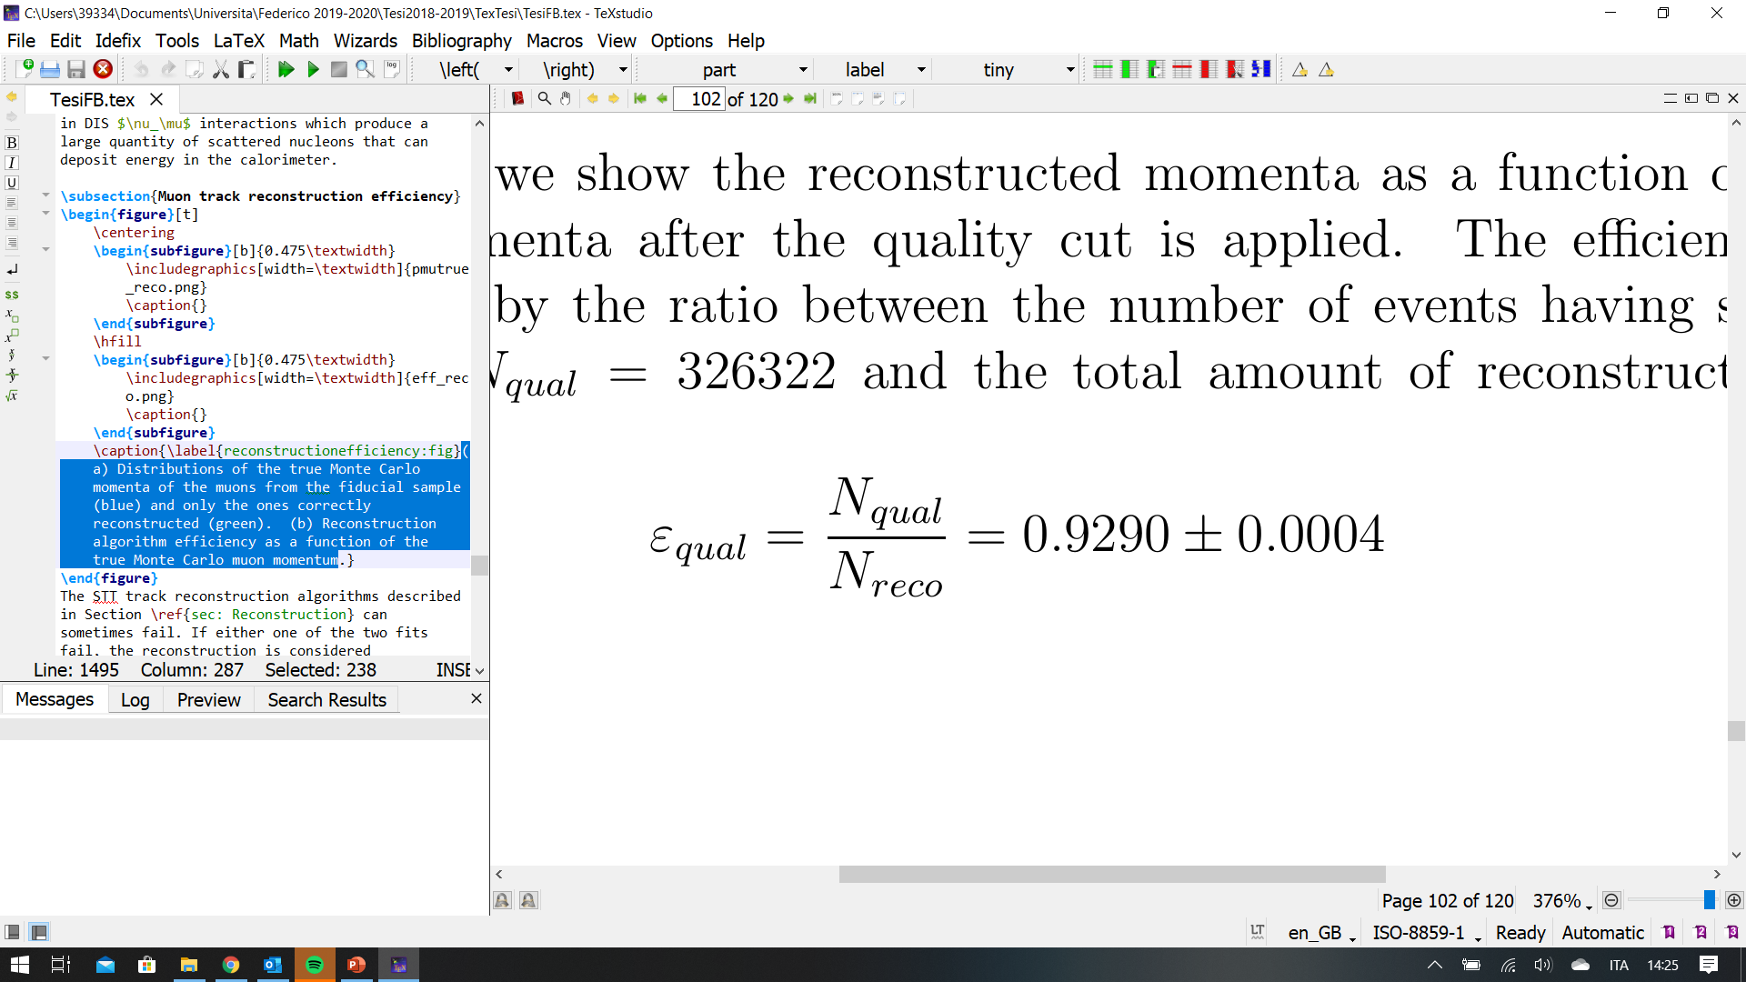
Momentum reconstruction quality selection

Slide 10
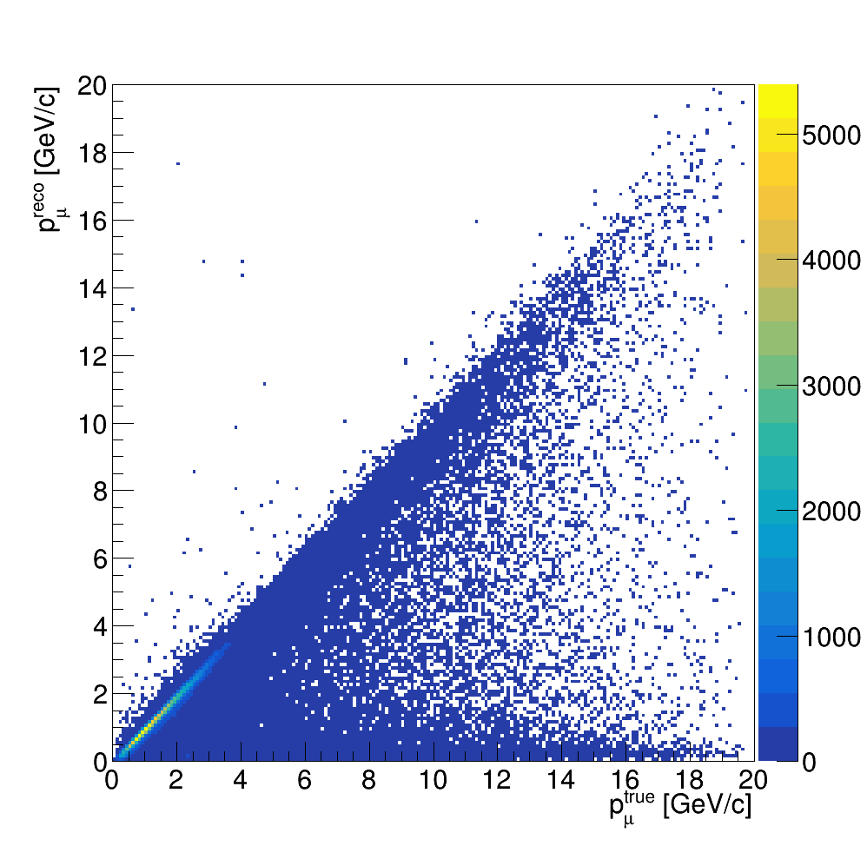
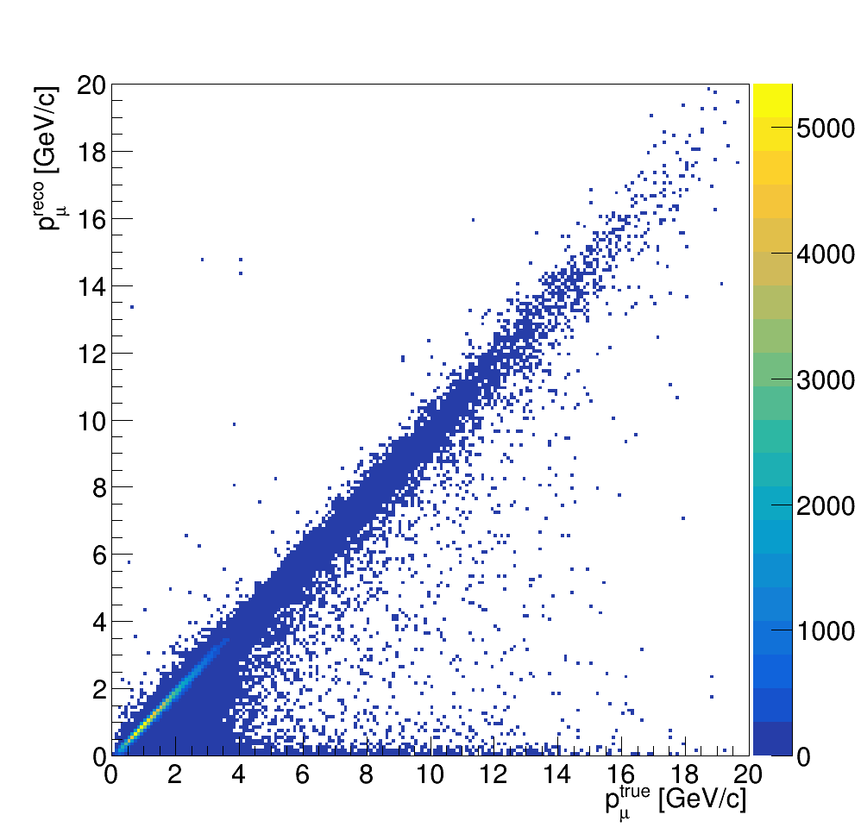
Momentum reconstruction quality selection
BEFORE CUT
AFTER CUT

Slide 11
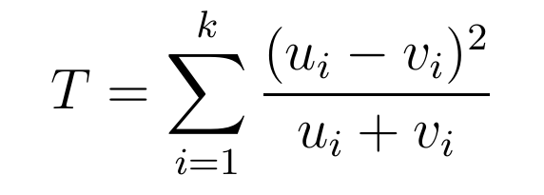
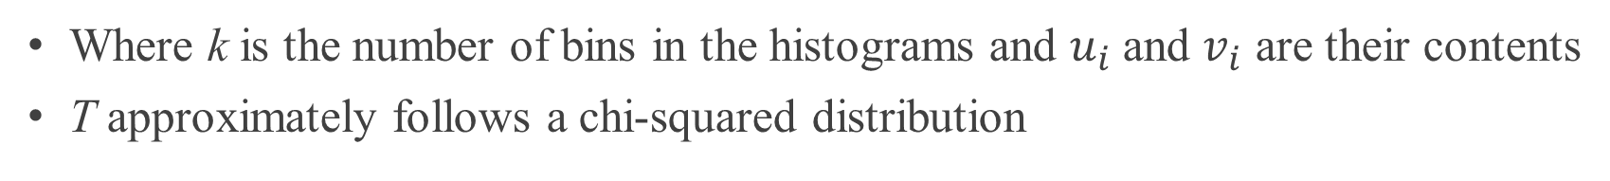
Chi-squared two-sample test statistics
Where k is the number of bins in the histograms and $u_{i}$and $v_{i}$ are their contents
T approximately follows a chi-squared distribution

Slide 12
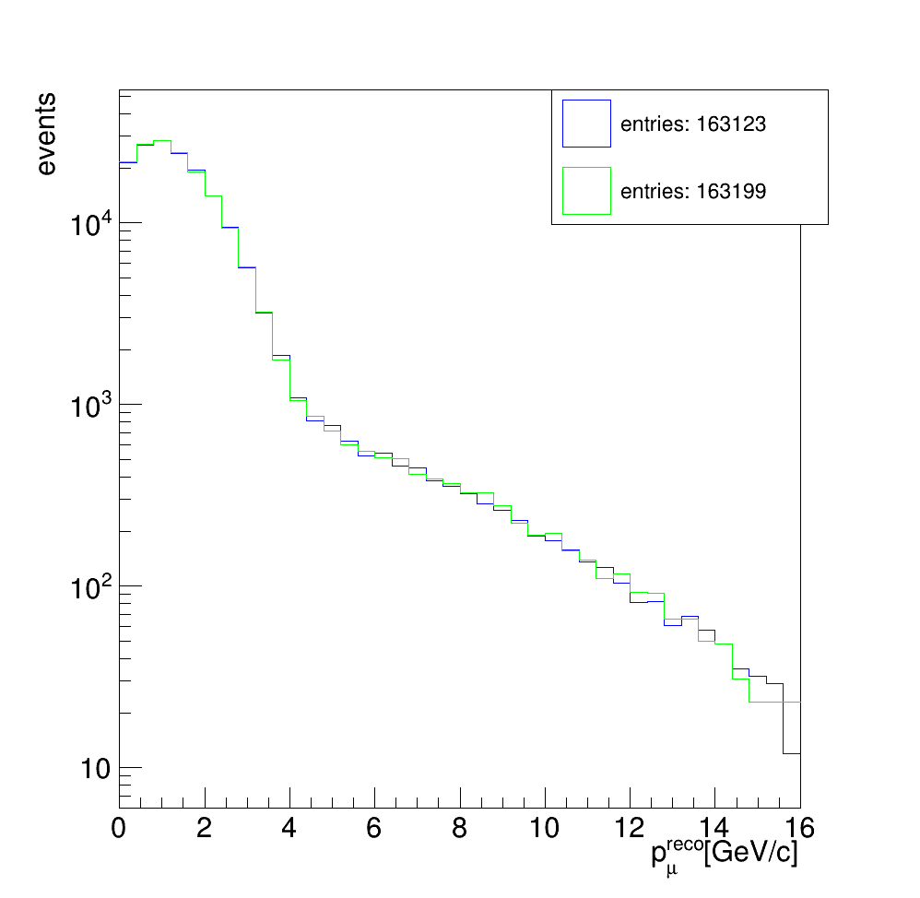
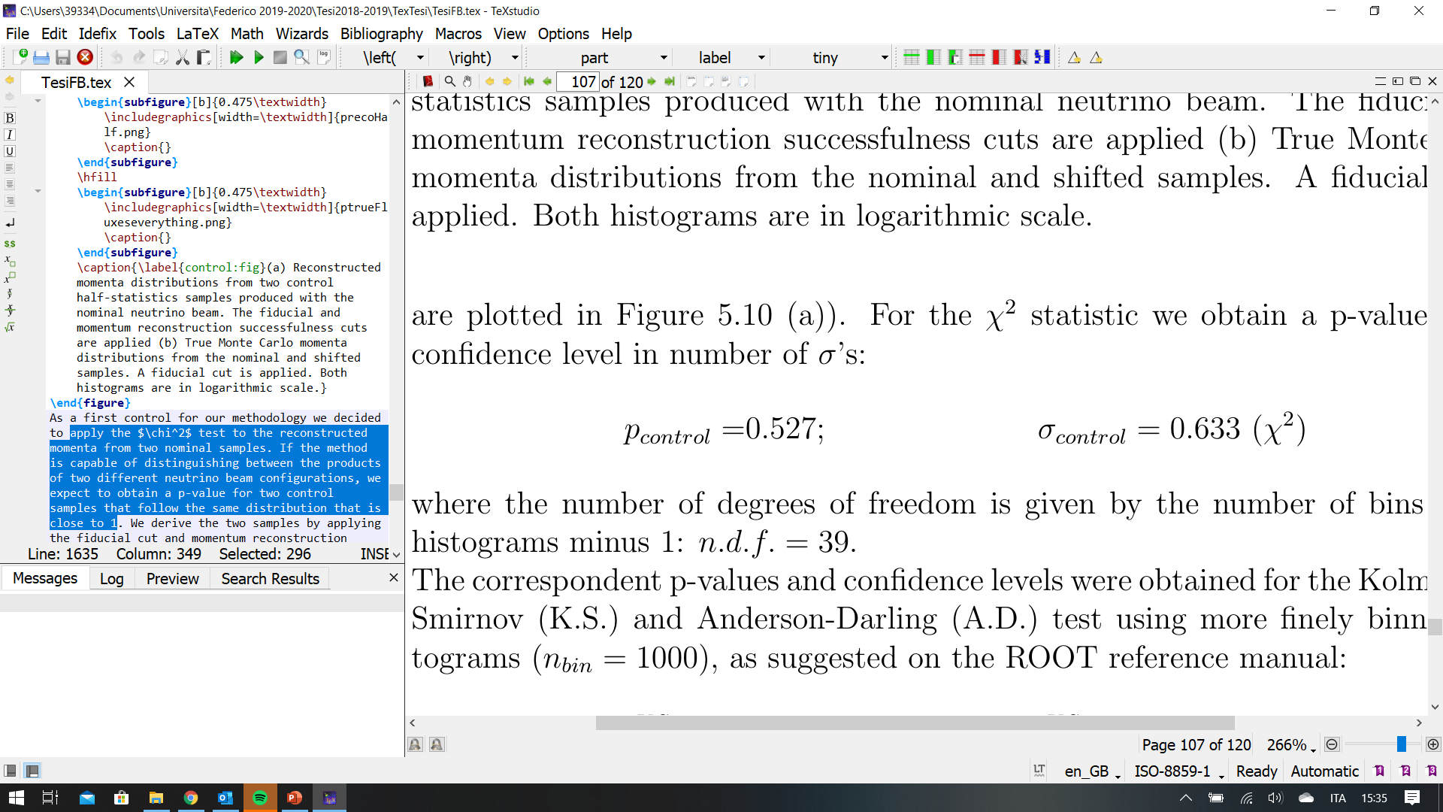
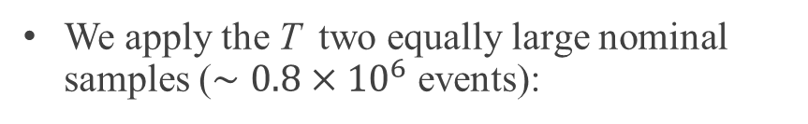
Control analysis: two nominal sampes
We apply the T two equally large nominal samples ($∼0.8×{10}^{6}$ events):

Slide 13
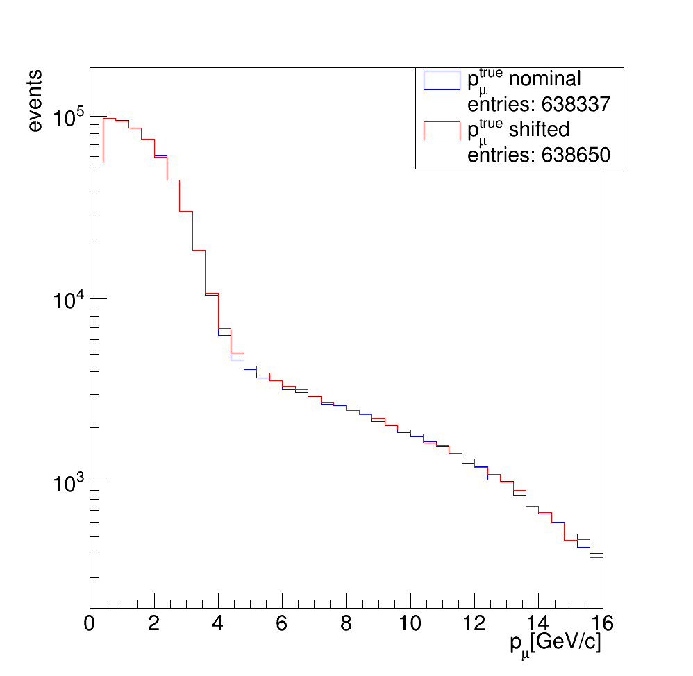
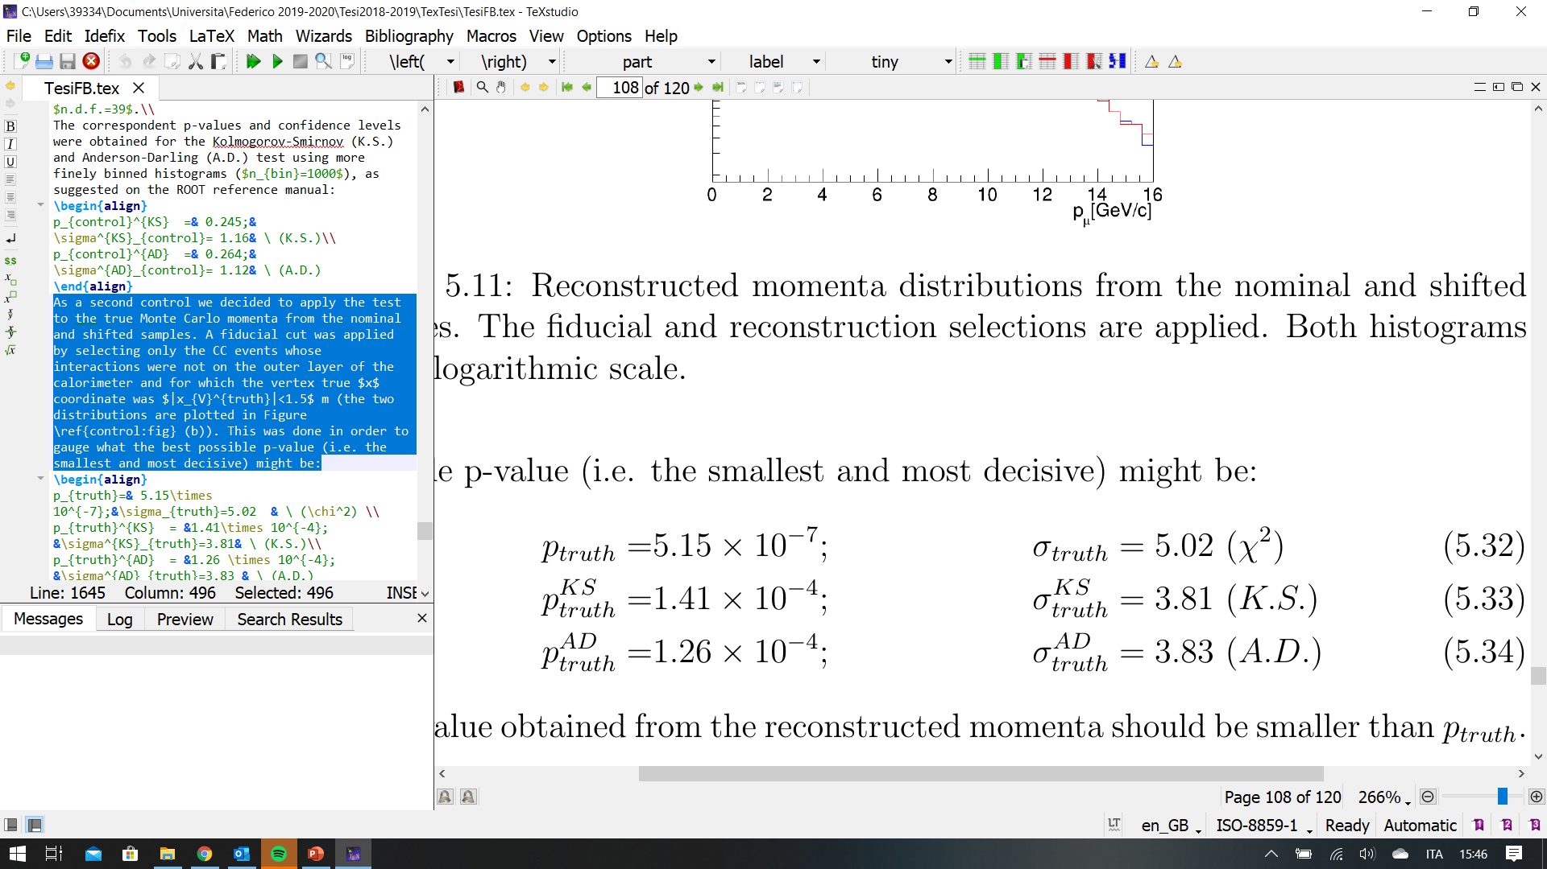
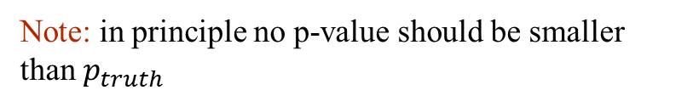
Control analysis: ideal selection
We applied T the test to the true Monte Carlo momenta from the nominal and shifted samples.
A fiducial cut was applied by selecting events whose true interaction position was in the fiducial volume
This was done in order to gauge what the best possible p-value (i.e. the smallest and most decisive) might be:
Note: in principle no p-value should be smaller than $p_{truth}$

Slide 14
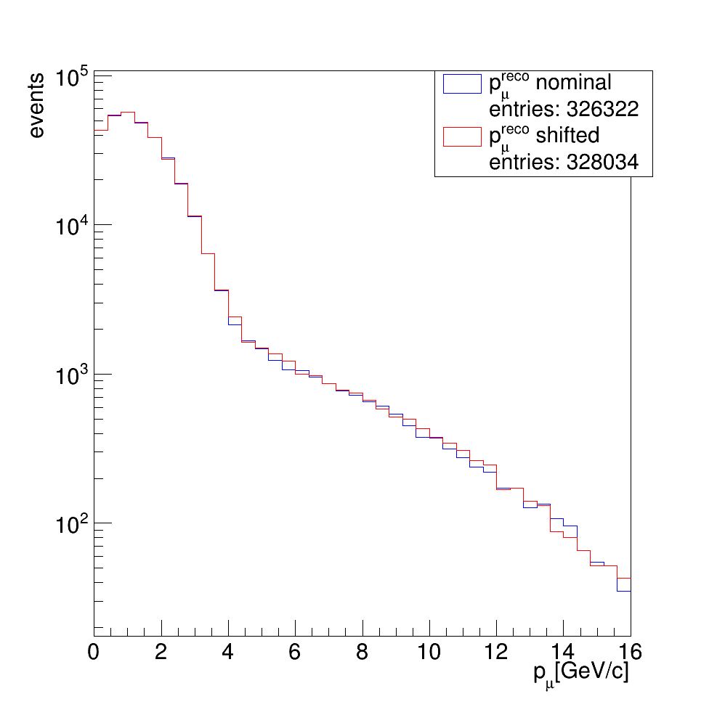
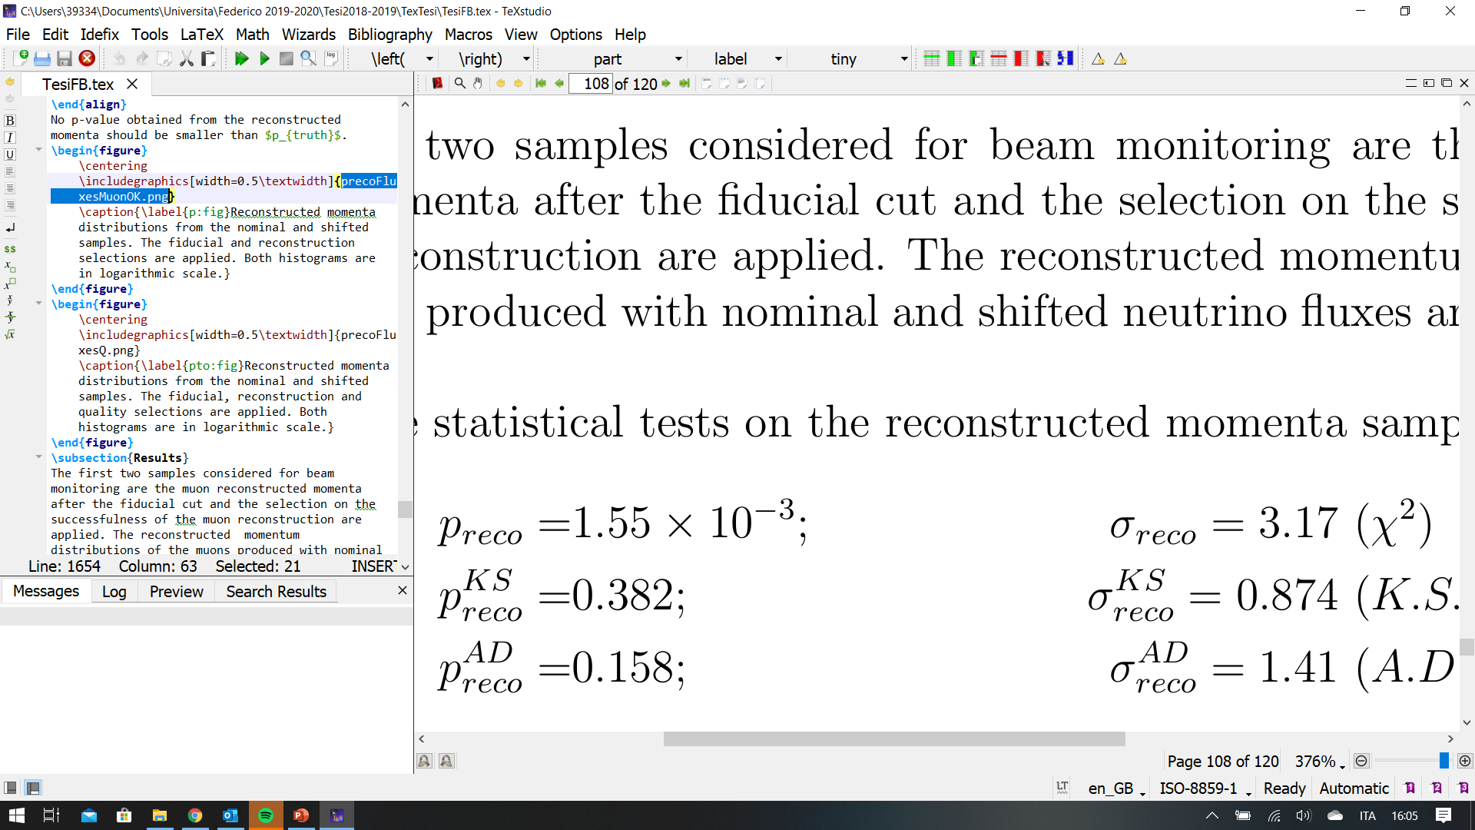
Results: fiducial + reconstruction

Slide 15

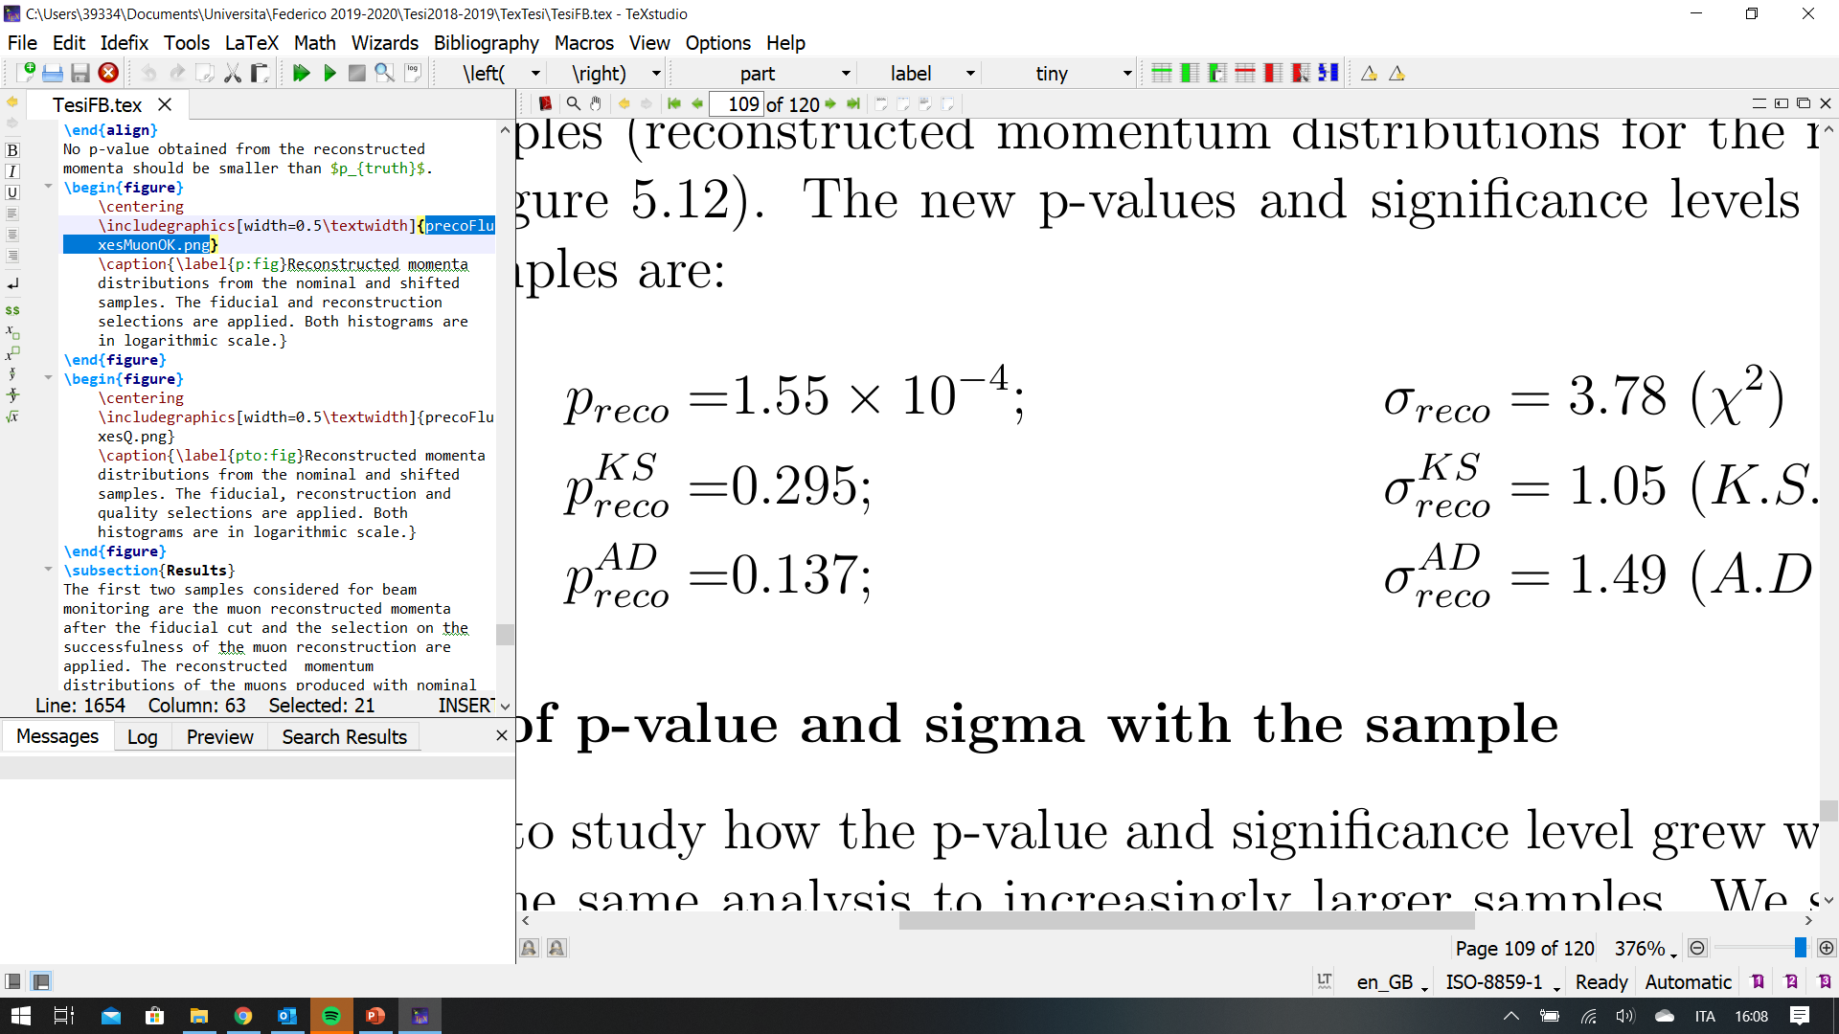
Results: fiducial + reconstuction + quality
We repeat the procedure by applying the quality cut to both samples:

Slide 16
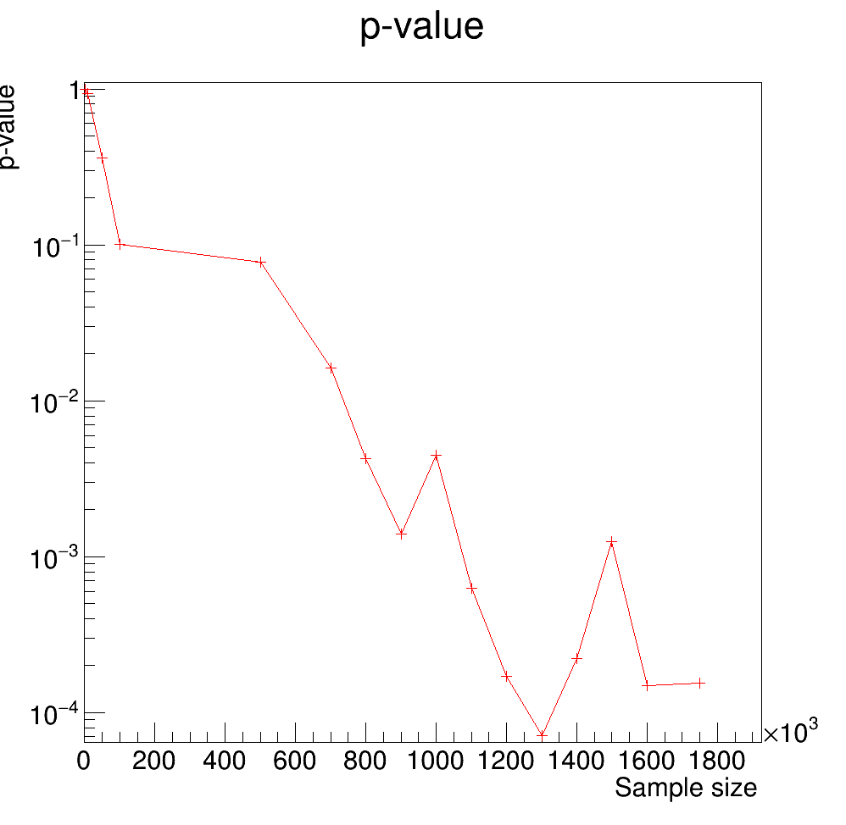
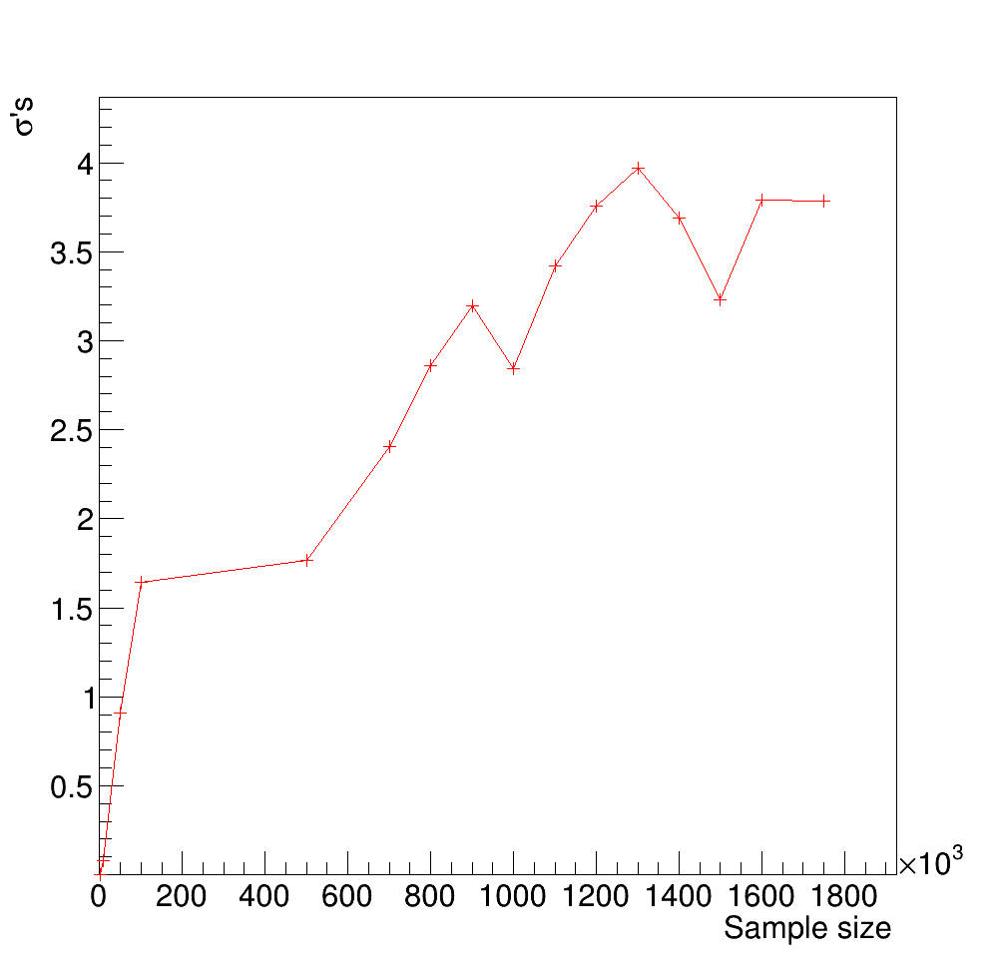
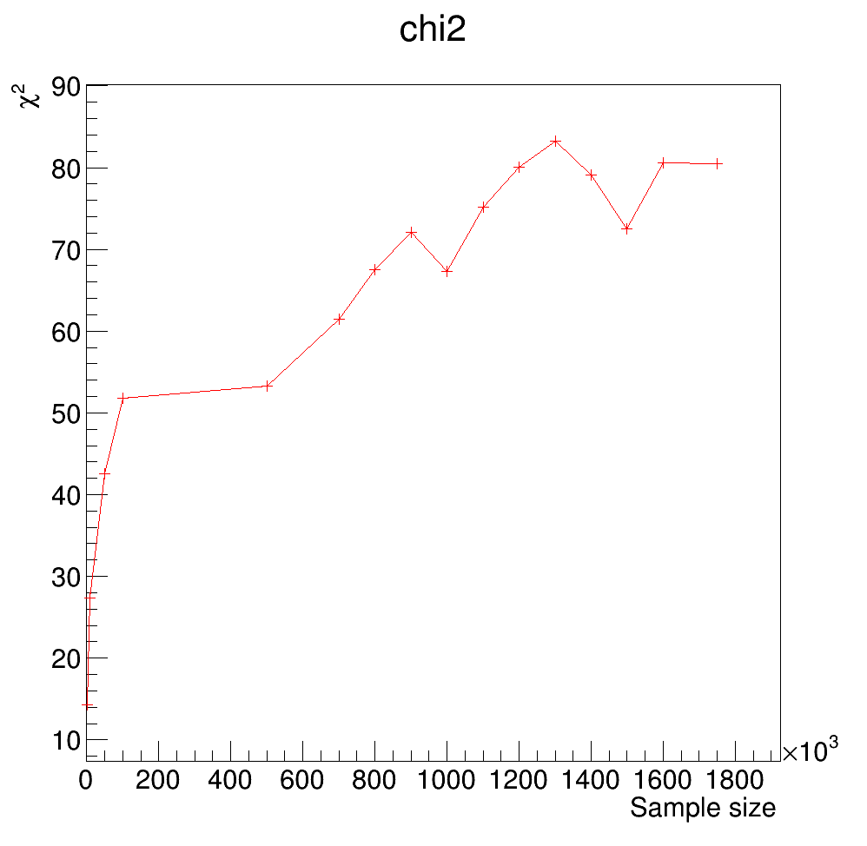
P-VALUE EVOLUtion with the sample
As we should expect, as the samples become larger the $χ^{2}$ and number of $σ$’s increase, while the p-value decreases.
With a sample grater than 1.2 million events, comparable to (even if smaller) that the one expected during a week of data taking, is possible to identify the beam anomaly with a confidence level corresponding to more than 3$σ$

Slide 17
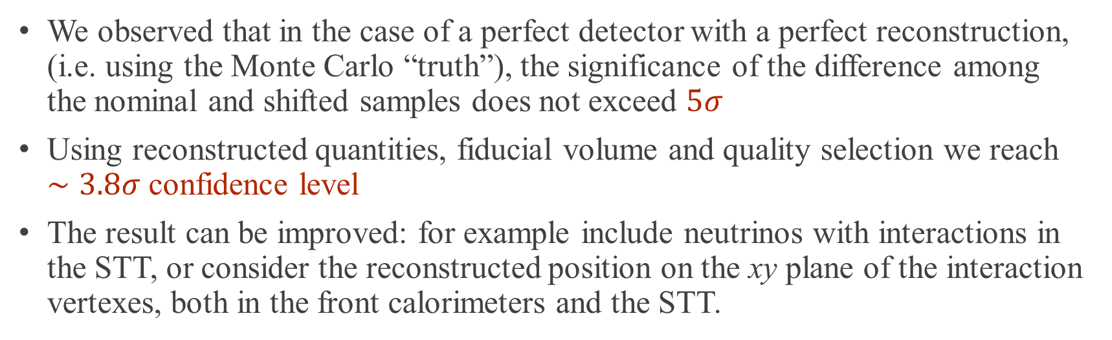
conclusions
We observed that in the case of a perfect detector with a perfect reconstruction, (i.e. using the Monte Carlo “truth”), the significance of the difference among the nominal and shifted samples does not exceed $5σ$
Using reconstructed quantities, fiducial volume and quality selection we reach $∼3.8σ$ confidence level
The result can be improved: for example include neutrinos with interactions in the STT, or consider the reconstructed position on the xy plane of the interaction vertexes, both in the front calorimeters and the STT.

